Slide 1
TMDB – MS Access DB
Screenshots and Core Functionality
Code Last Updated for MS Office 2013 Release

Slide 2
What The User Sees
Load .accde files to experience the Database as a User

Slide 3
Highlights of the Database
This presentation does not show everything the Database has to offer.
It just shows menus and some highlights of major features and functionality
The UI is configurable code that could be used to build other code
Since not everyone has MS Access on a home or work system, these slides will help you see what was built
Slides in this section were use screen captures from: TM-DB-MS2013v2_Demo.accde

Slide 4
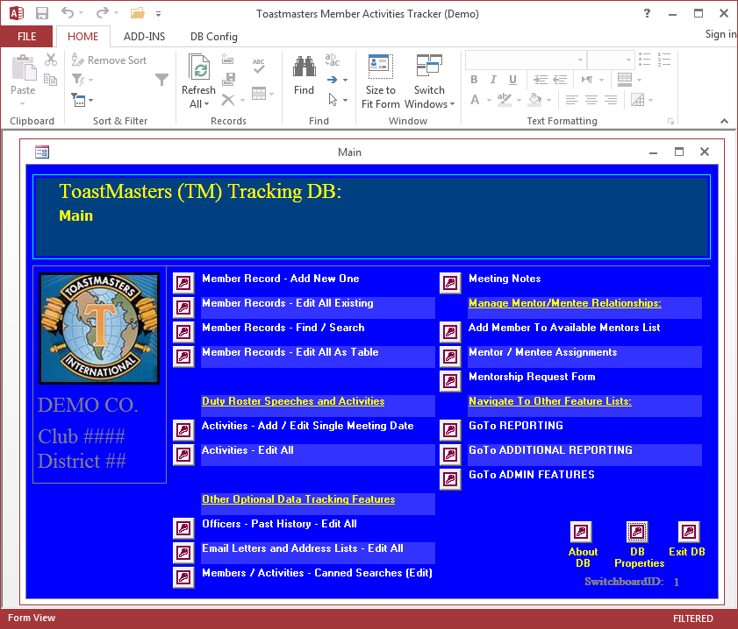
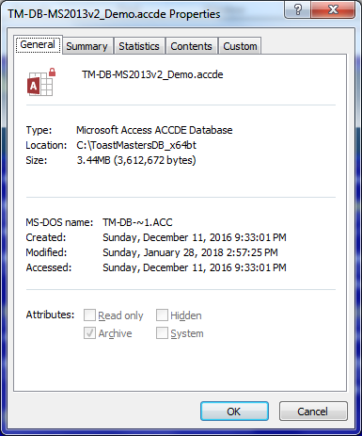
Main Splash Screen
Yellow dashboard entries are headings
White entries trigger features or navigate to
More dashboards with more feature links
Features include:
Forms for Variety of Tasks
Data Views
Reporting that Exports Data to Excel
Etc.
Corner buttons appear on all Dashboards

Slide 5
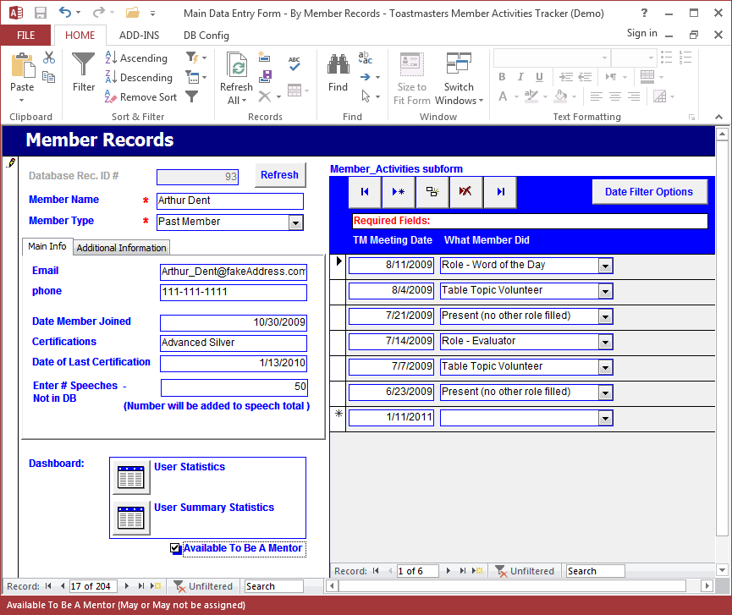
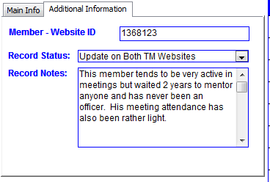
Add/Edit Club Member Records
Clicking Additional Information tab:

Slide 6
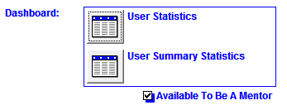
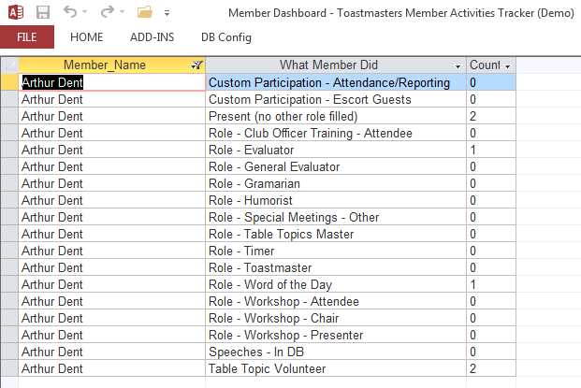
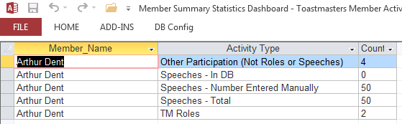
Clicking Dashboard Buttons (Prev. Screen)

Slide 7
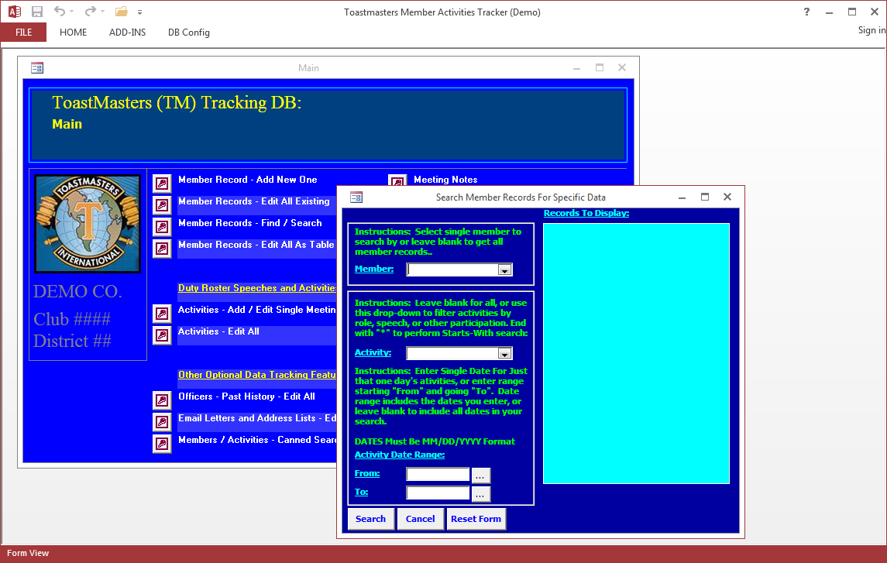
Searching For Specific Member Records

Slide 8
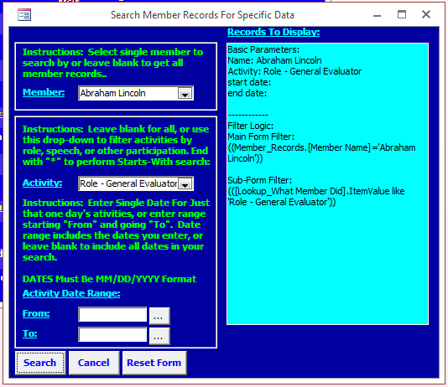
For Technical Users
Search Screen exposes Query logic used by user selections
This can help users understand SQL
This can help admins debug a problem should one come up

Slide 9
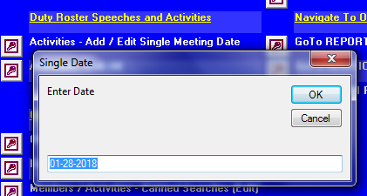
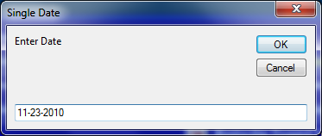
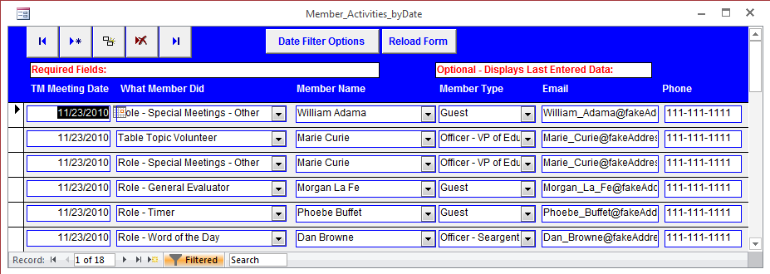
Editing Child Records by Specific Meeting Date

Slide 10
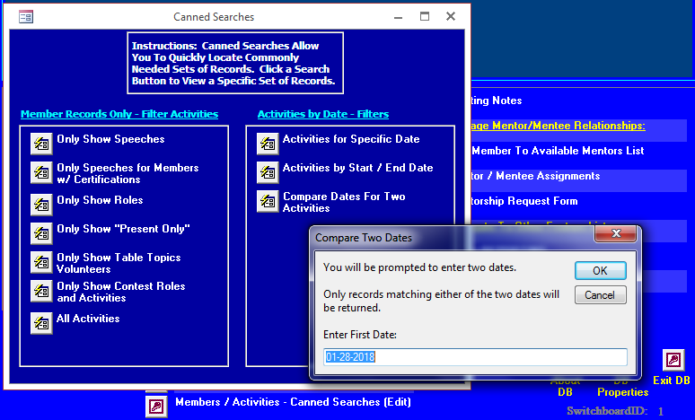
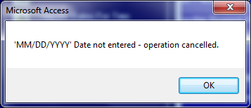
Canned Searches w/ Prompts to User
Example: User hits Enter
w/o entering date:

Slide 11
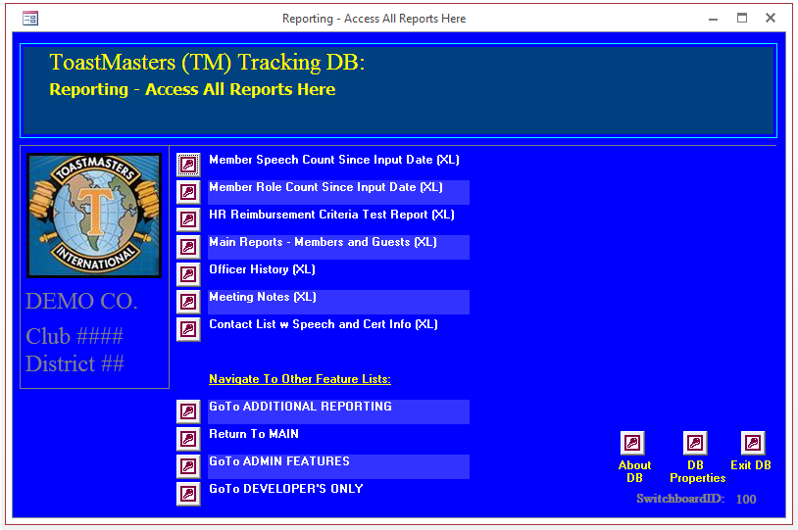
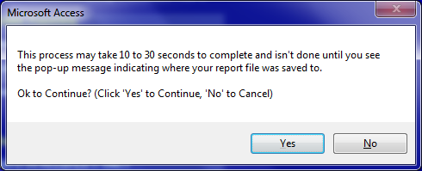
Reporting Buttons Output Content To Excel
Messages warn users and allow them
To cancel for reporting processes that
May take a while:

Slide 12
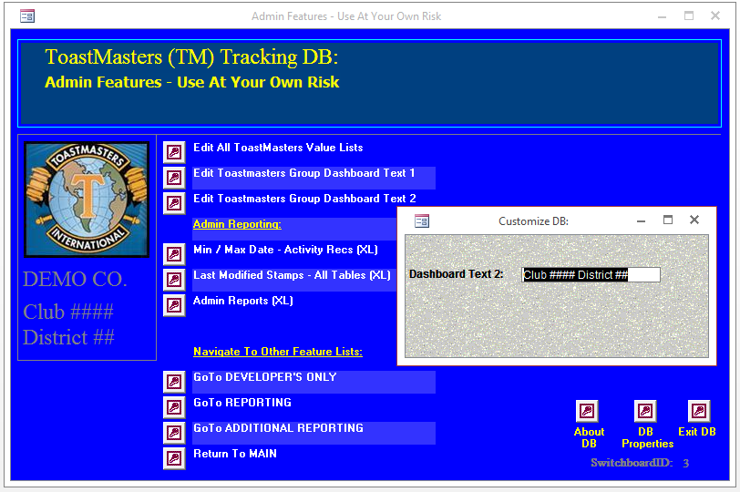
Admin Features
Admin features allow limited customization of the text displayed by the UI and presents reporting more useful to Admins than general Users

Slide 13
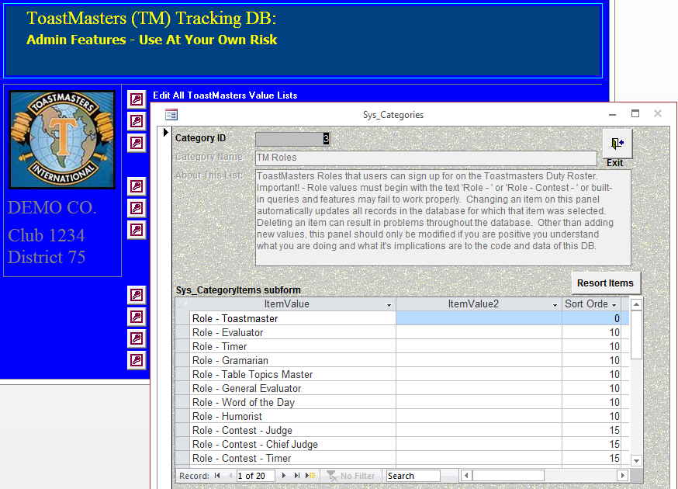
This Includes Editing Lists Used in Drop Downs

Slide 14
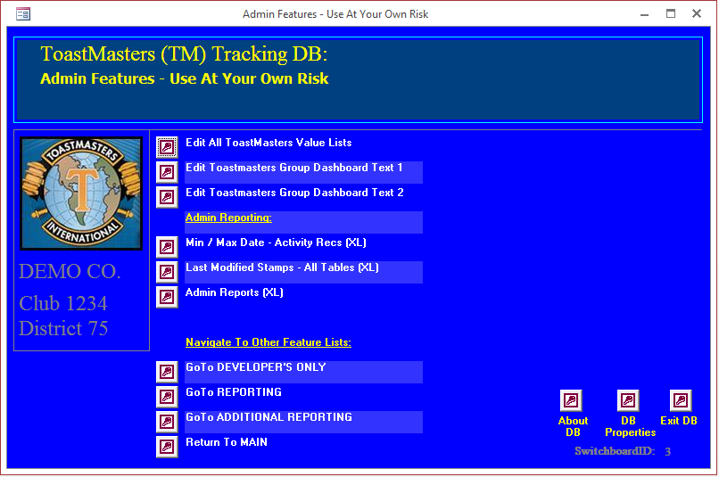
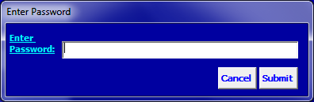
Developer and Trusted User Only Features
Password challenge locks
Down Developer Dashboard

Slide 15
Developer Perspective
Load .accdb for Admin Access to Source Code
.accde files generated from .accdb file

Slide 16
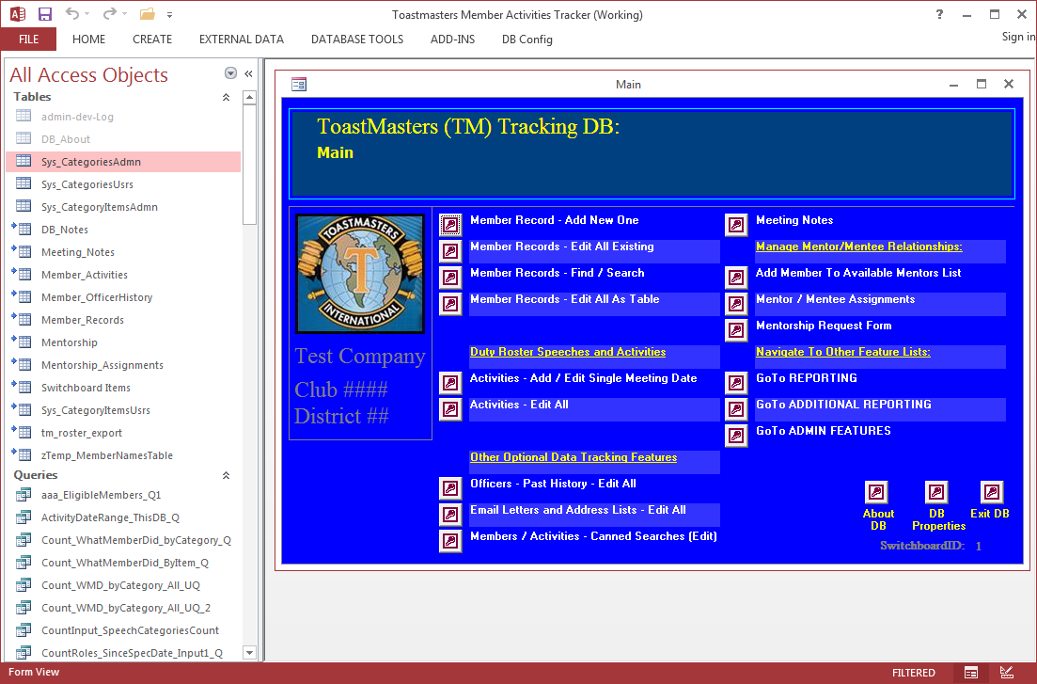
Developer Copy of The DB (On Load)
Scroll down of additional
Objects in the “All Access Objects”
Panel follows on Next Slide.

Slide 17
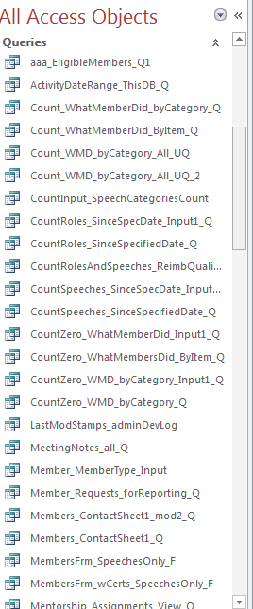
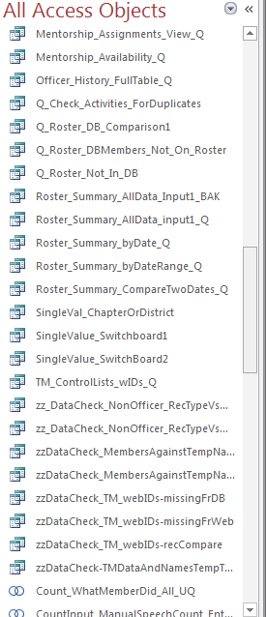
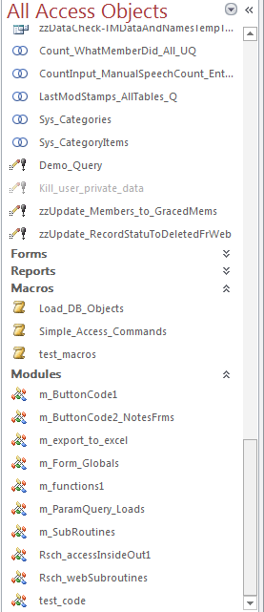
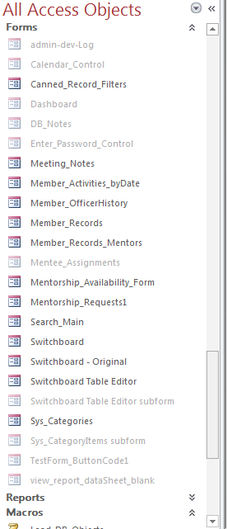
Scrolling Further in All Access Objects Panel …

Slide 18
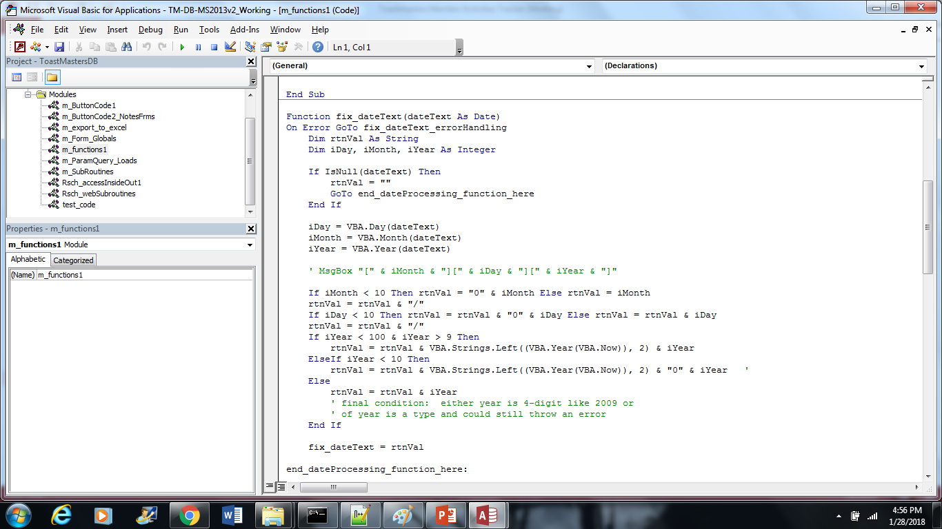
Code Modules In MS Access VB

Slide 19
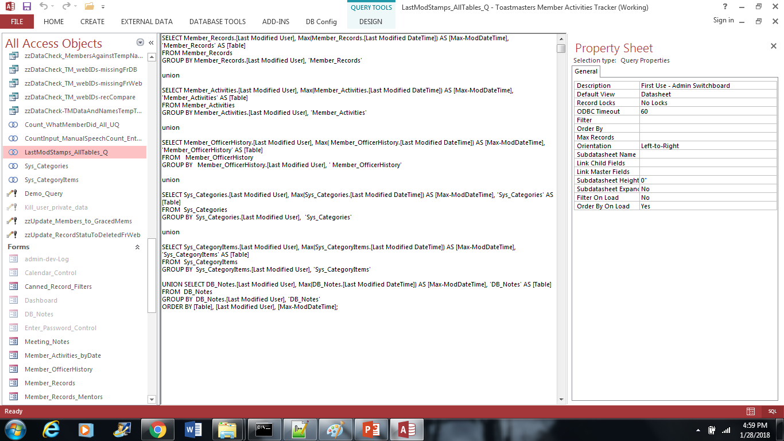
SQL in MS Access

Slide 20
Reporting In Excel
Reporting start the process from MS Access
Then it Hands The reqults of SQL Queries off to Excel
In Excel, a Template w/ DB takes over the process using Excel VB
Access waits for it to finish and provides the user with a helpful message about where to find the resulting report

Slide 21
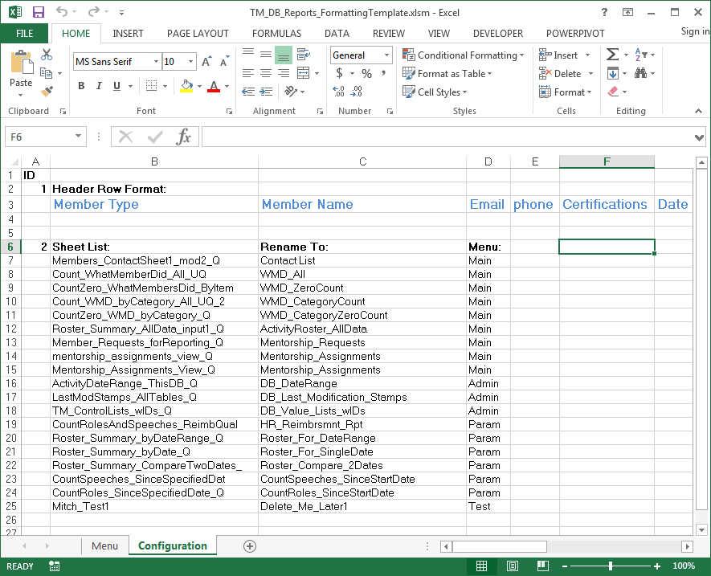
Excel File: Configuration Tabs
Some simple changes to reporting code
Are handled as simple edits to the
Excel file without having to edit the code

Slide 22
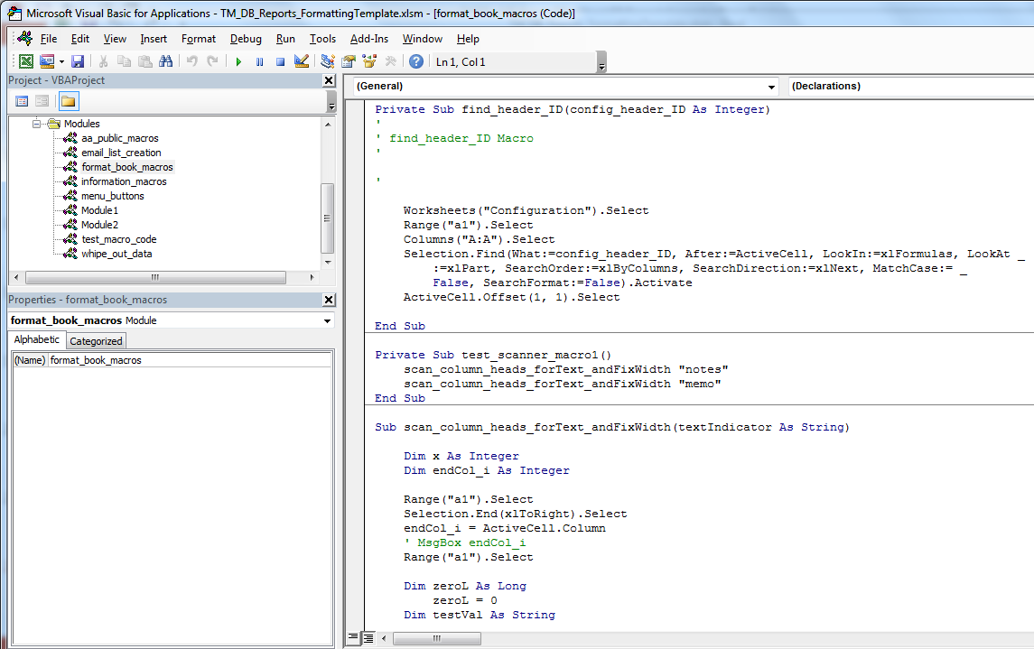
Excel VB (To Complete Reporting)

Slide 23
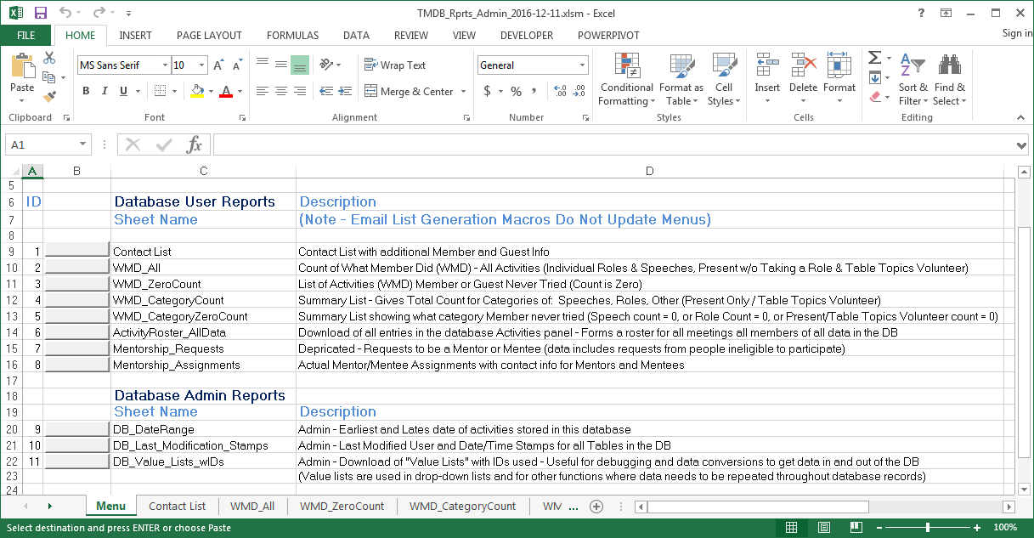
Menu Tab on Detailed Excel Workbook Output
The menu
Tab on reporting
Workbooks can be
Edited in the Code
Excel file w/o
Needing to edit
Actual VB code
Code modifies
This tab for each
Report type

